Slide 1
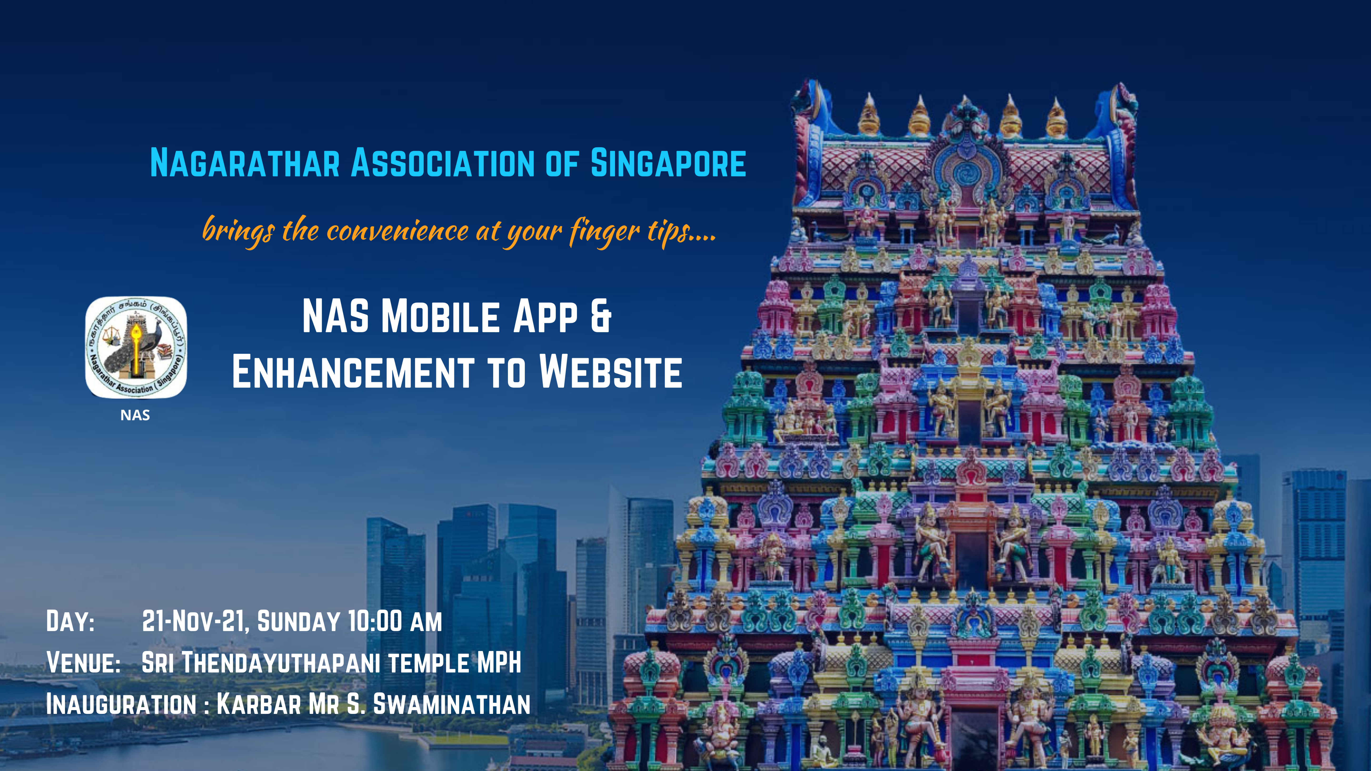

Slide 2
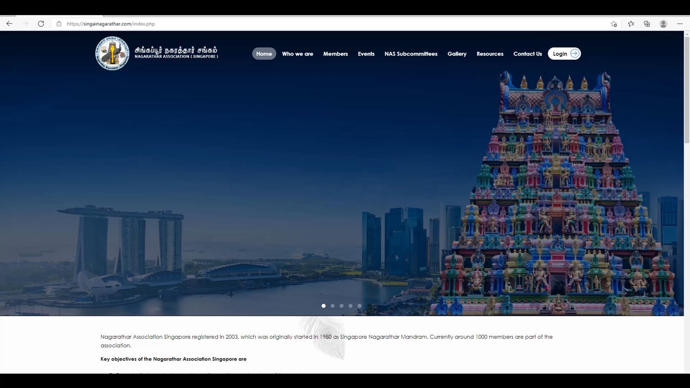

Slide 3
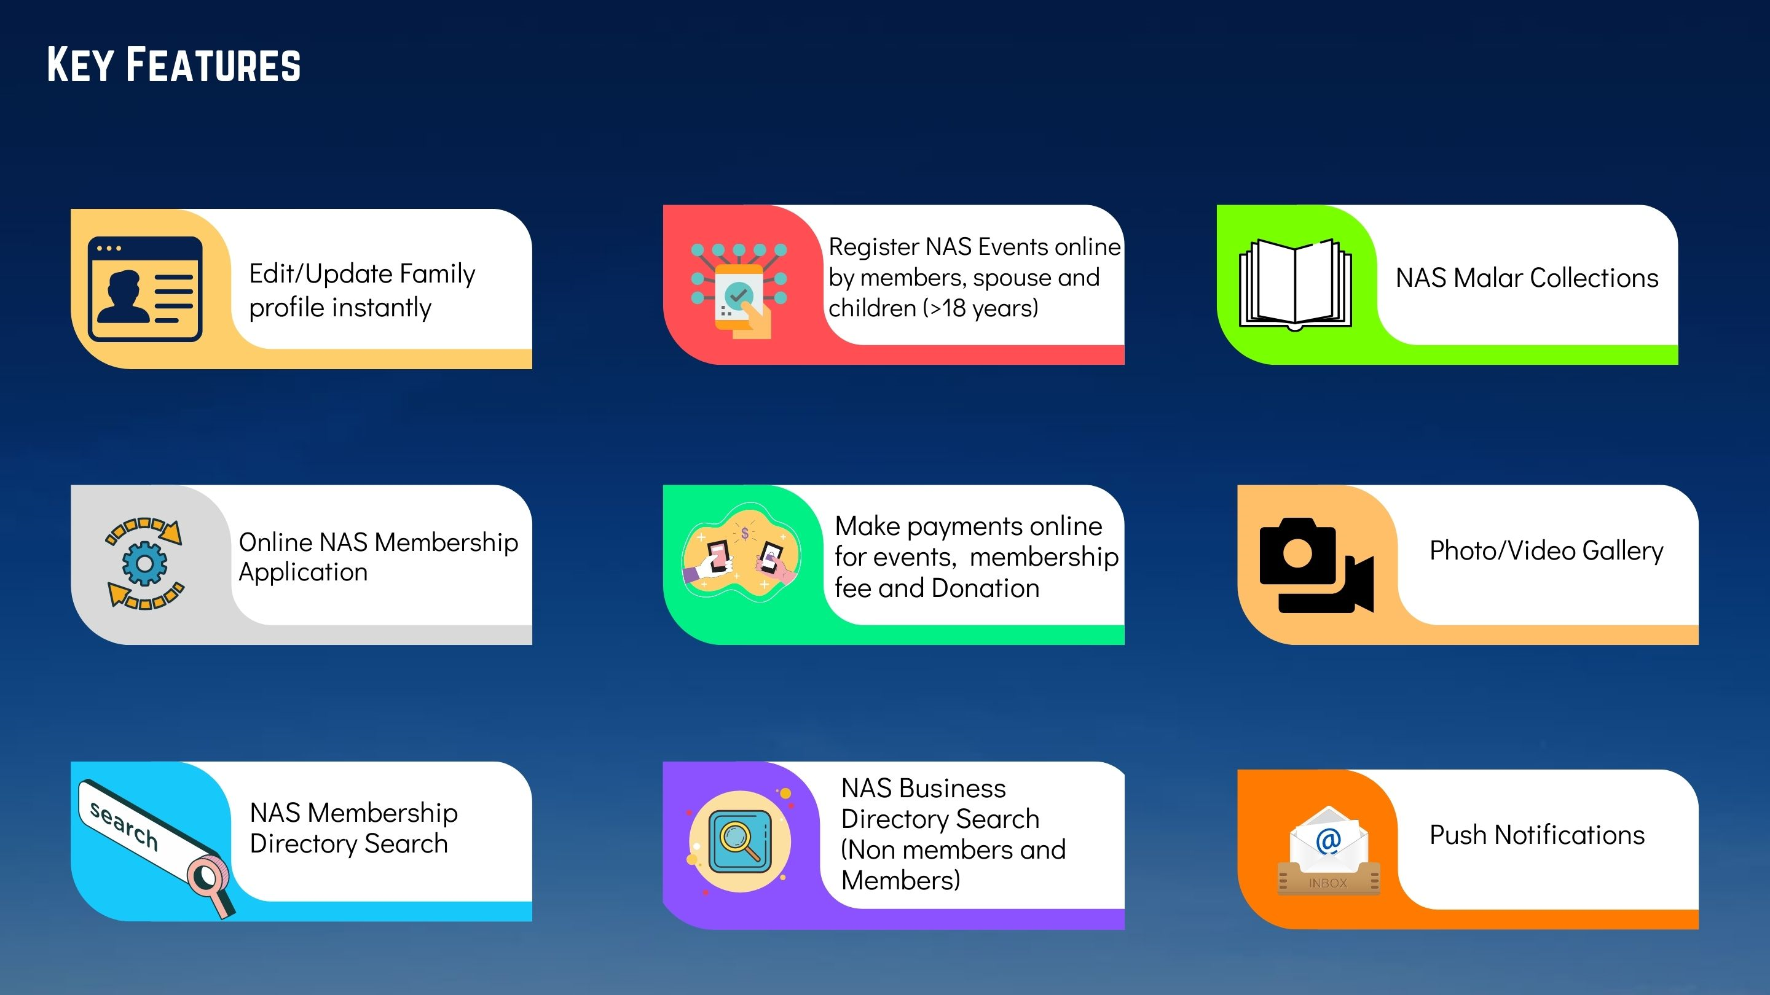

Slide 4

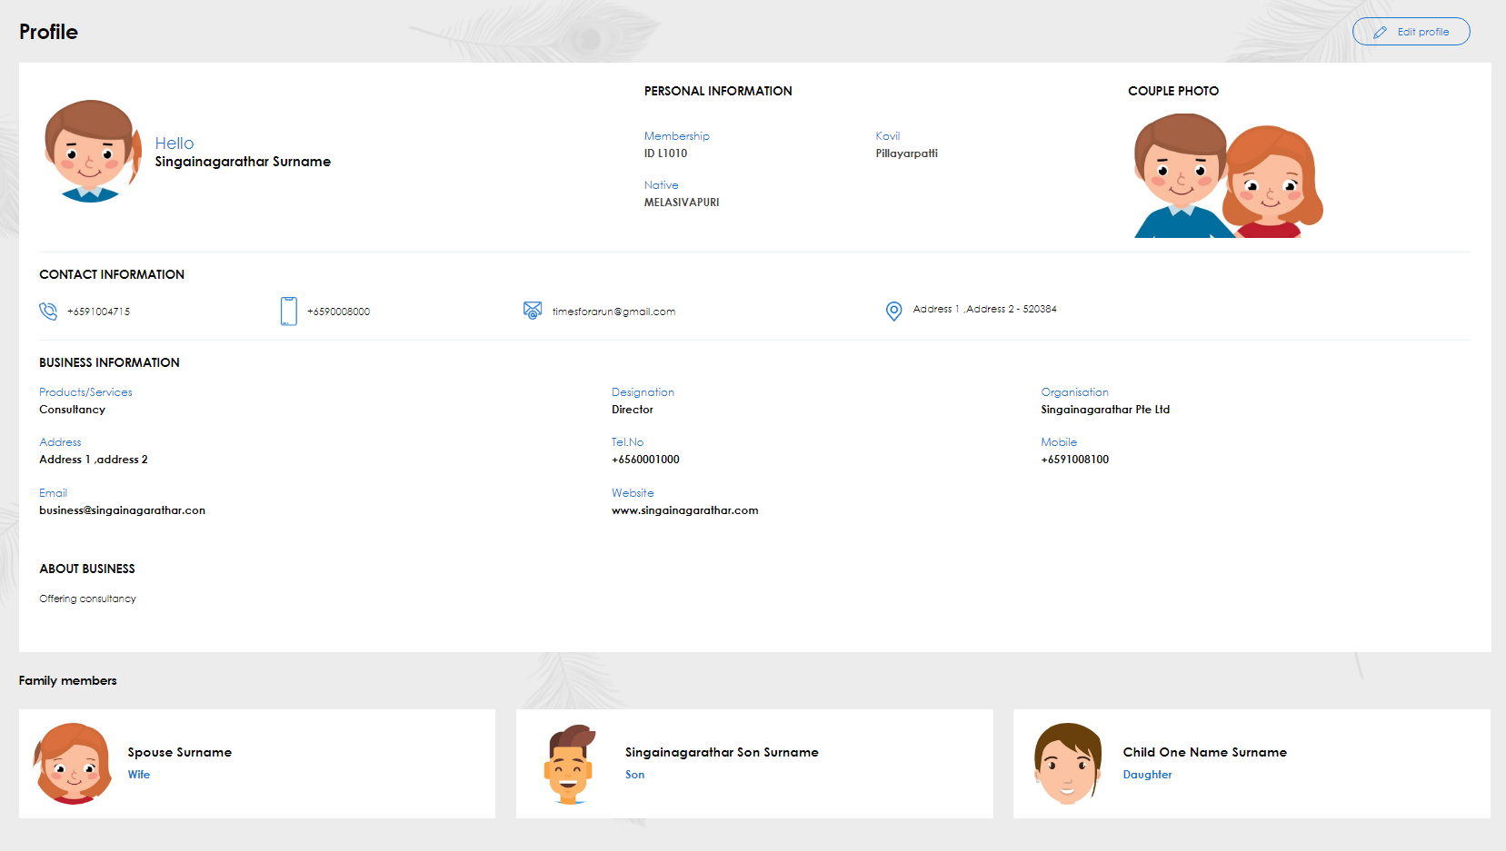
1. Profile Update
Access to Spouse
Members Update own profile
Add Family member
Profile Update
Access to Children (>18 years old)
Add Children(<18 years old) for event registration purposes

Slide 5
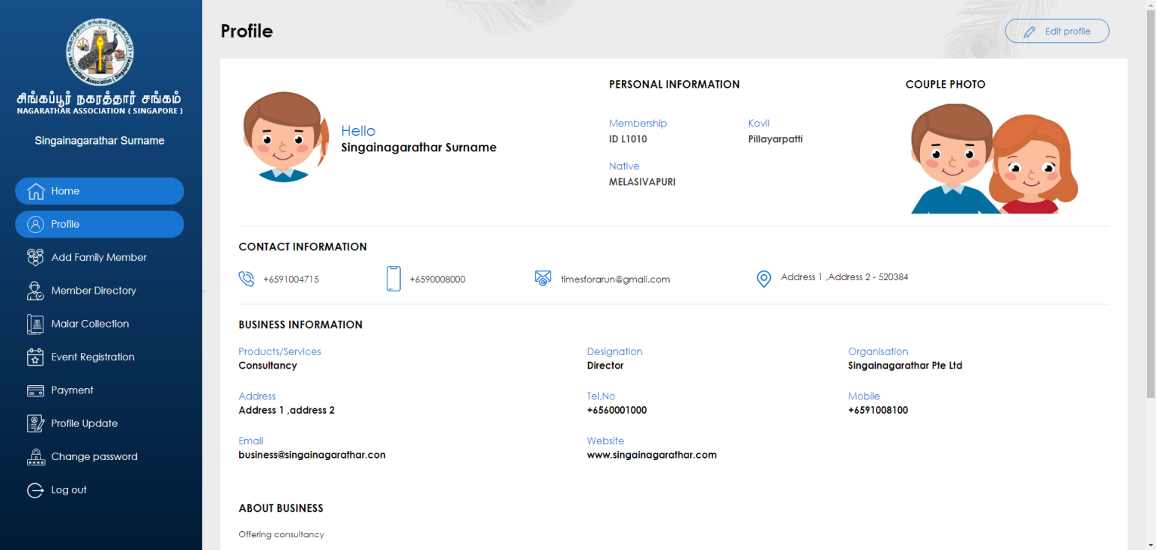
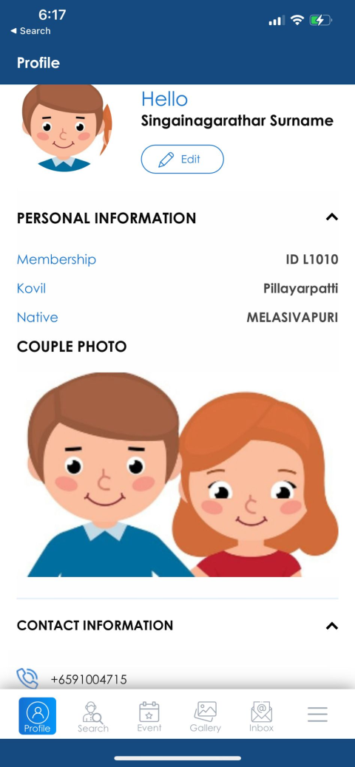
1. Profile Update
Members Update own profile
Update the profile pictures and other relevant details
Any edits to profile picture or details will be effected immediately
Option to add in your Business Information which will be visible under the business directory search to the members/non-members

Slide 6
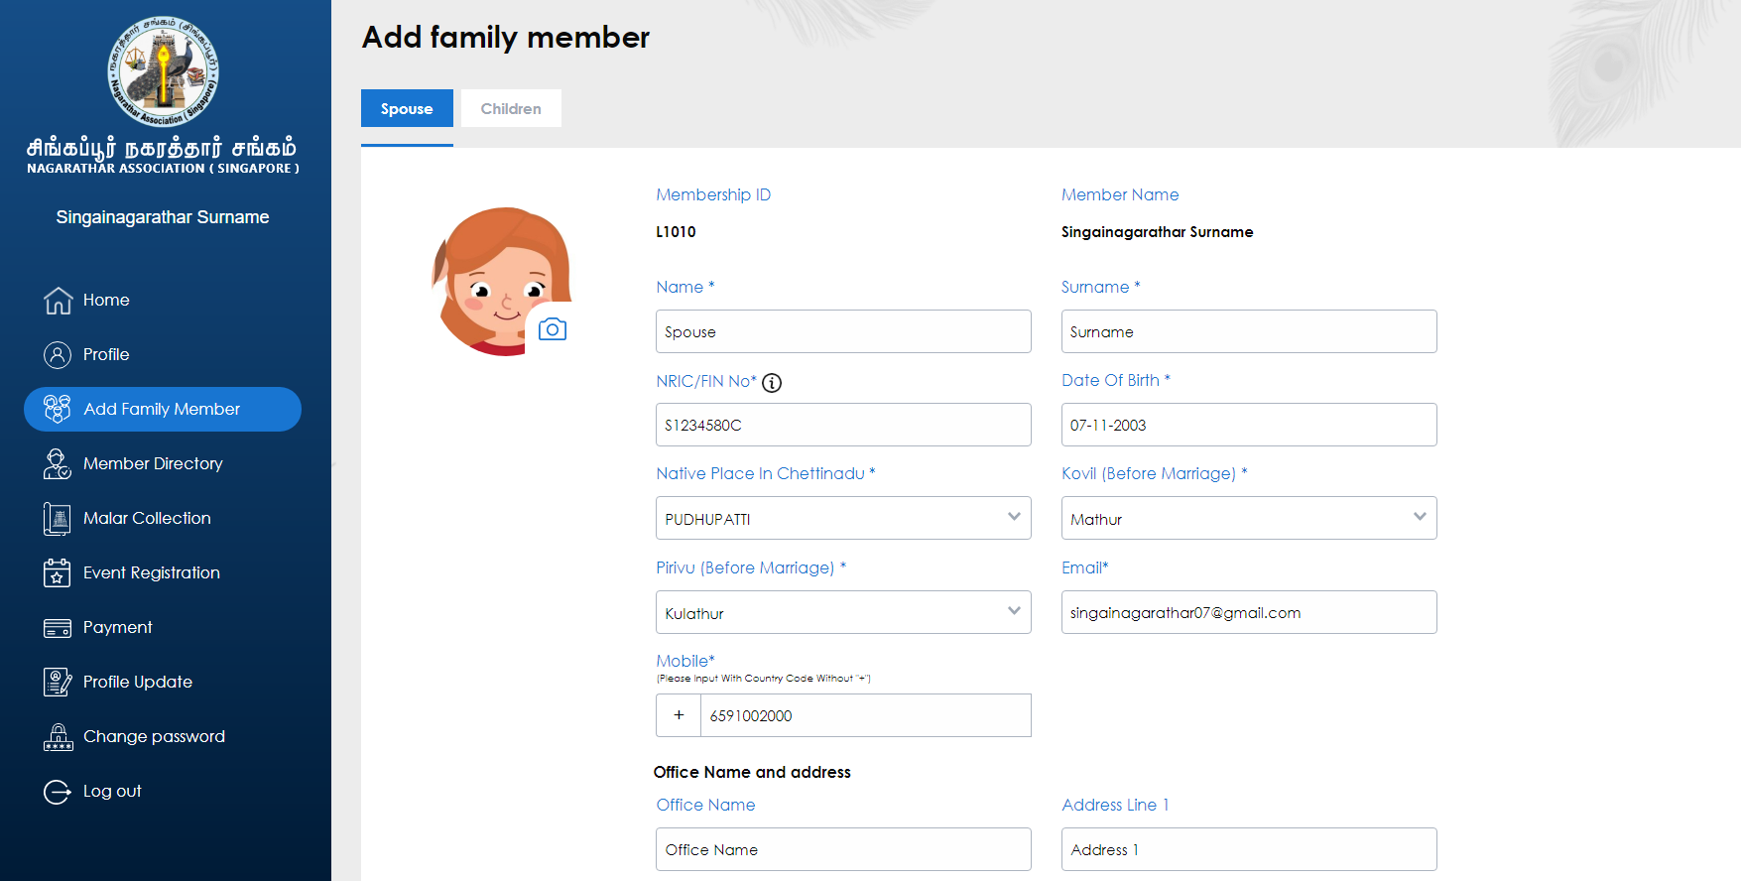
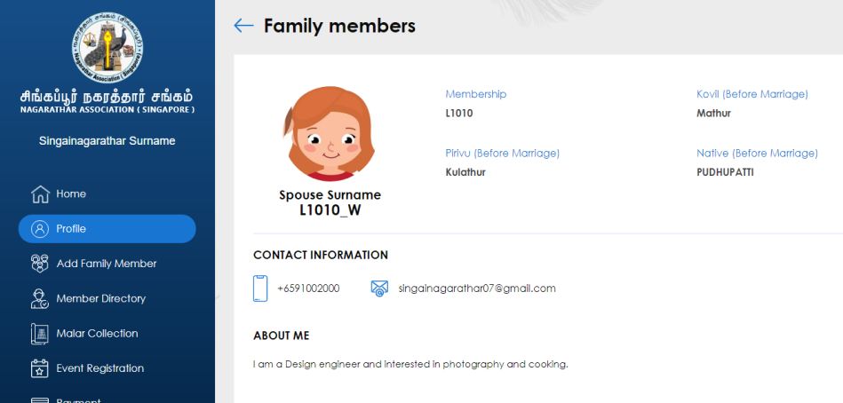
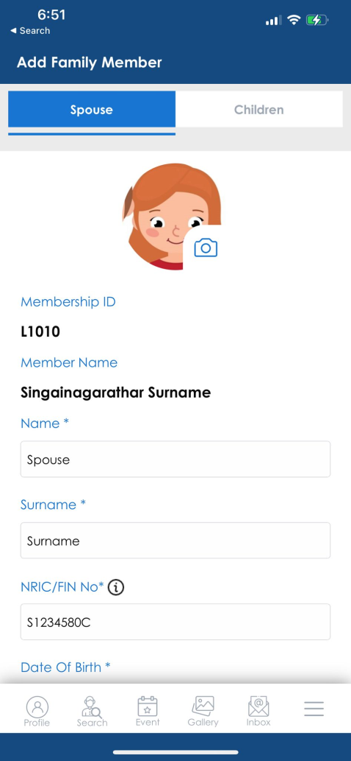
1. Profile Update
Add Family member
Add spouse details (Only, if the spouse details were not updated in the previous system)
Upon submit, the User ID/Password for Spouse will be generated to the provided email.
Spouse can login with the User ID “Membership ID_W”.
Example L1010_W

Slide 7
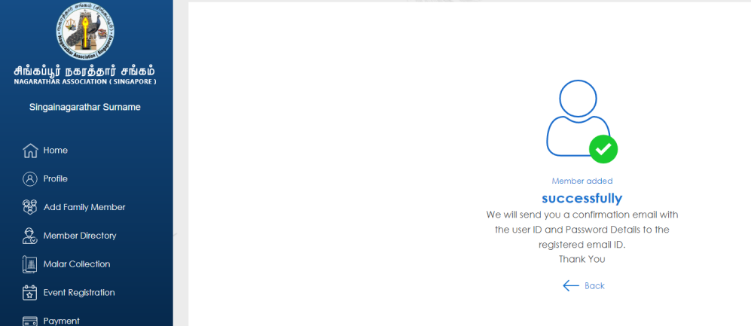
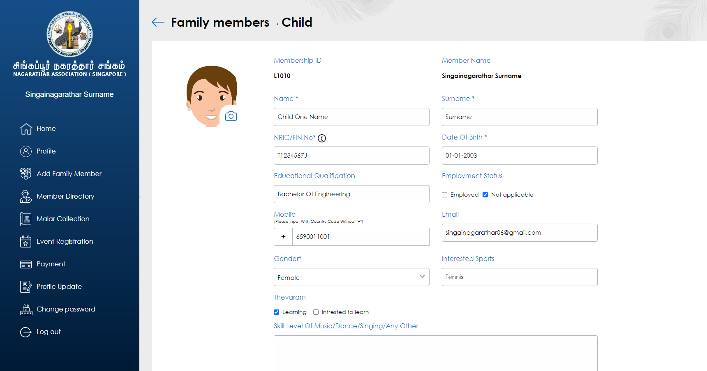
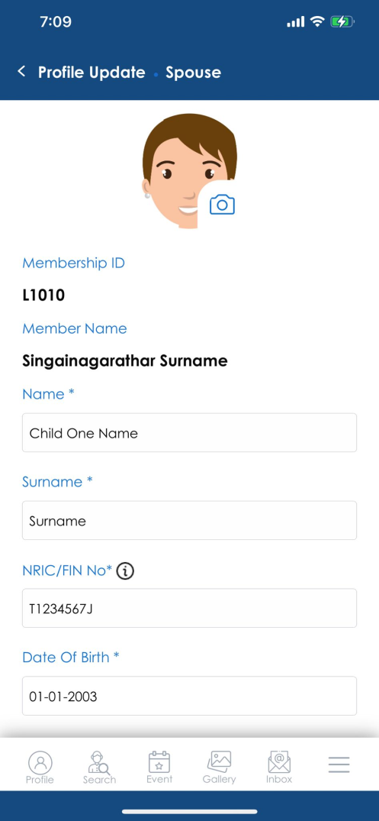
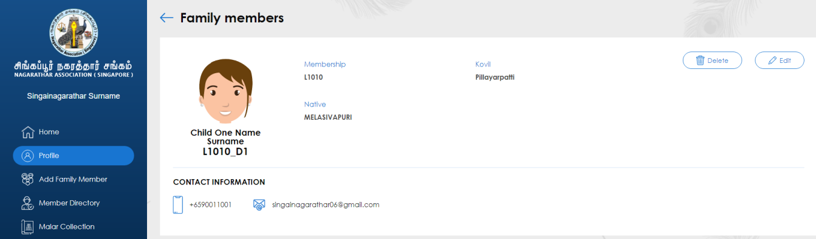
1. Profile Update
Add Family member
Add all the children's details (Children details needs to be added, to register them for events moving forward)
Children with age > 18 years will receive the User ID and Password in the provided email
Children can login with the User ID “Membership ID-D1” Example L1010_D1 (Daughter 1), L1010_D2 (Daughter 2), L1010_S1 (Son 1) etc.,

Slide 8
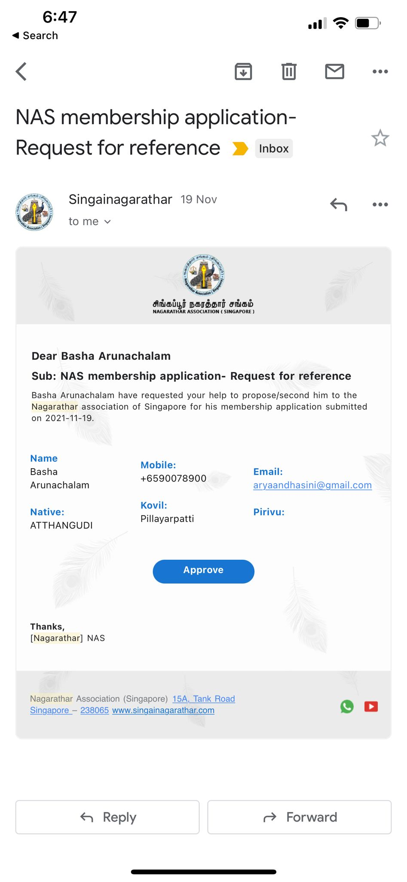

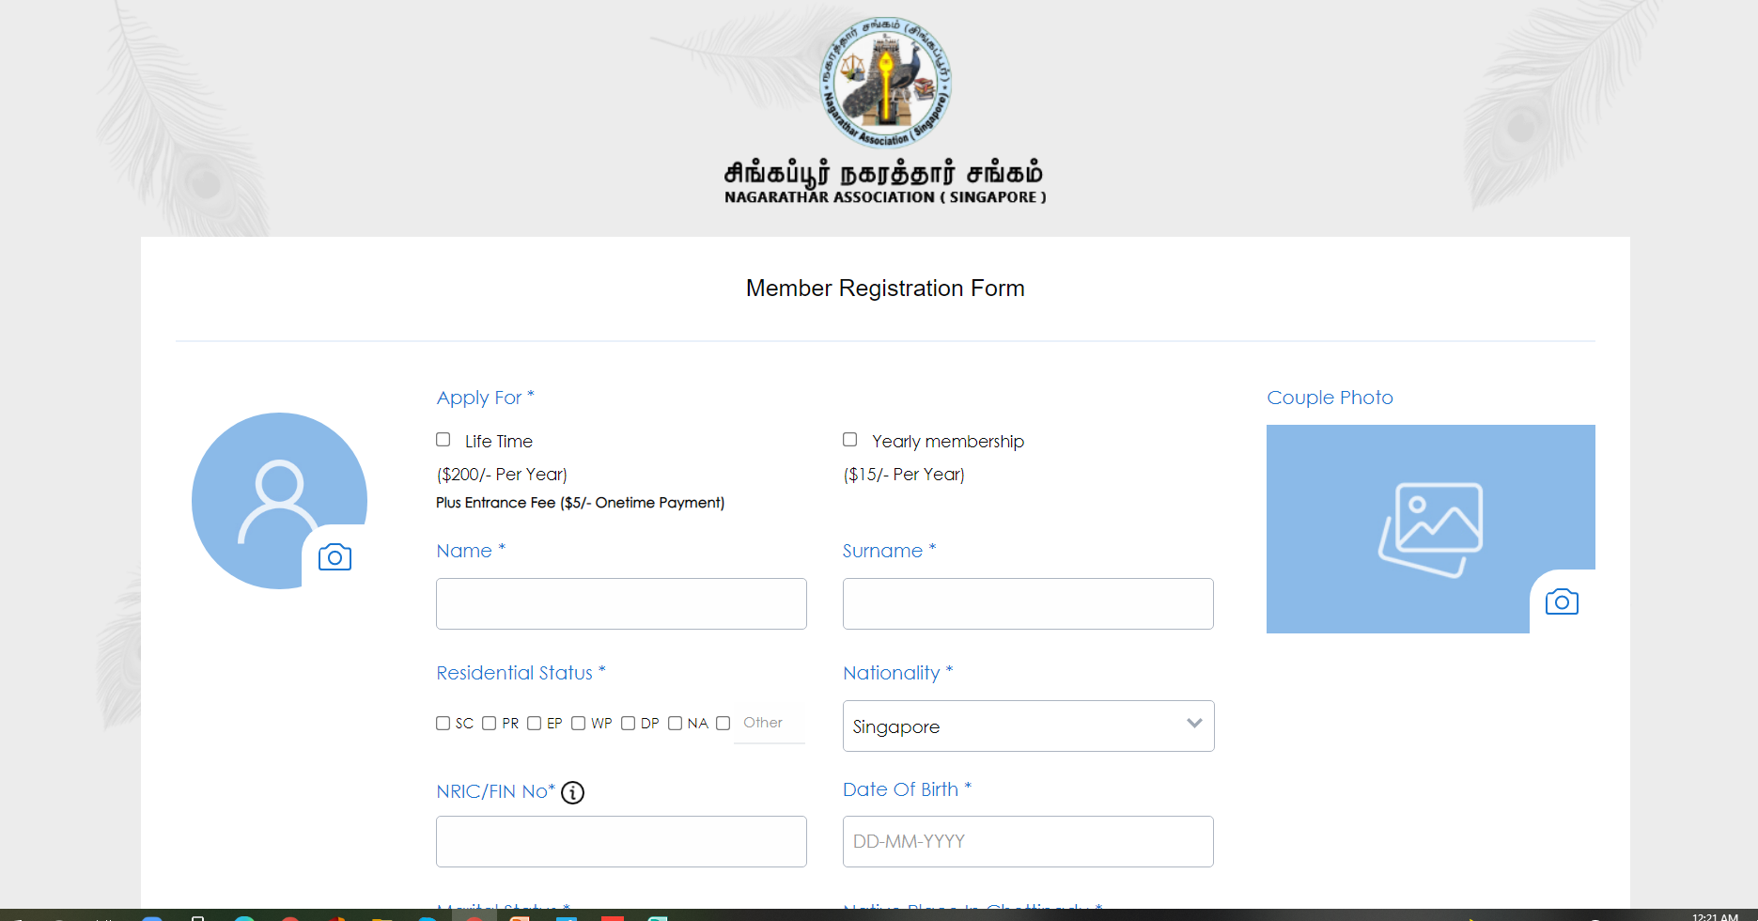
2. Online NAS Membership Application
NAS has enabled online application forms to apply for NAS membership
All the relevant details can be filled with Proposer and Seconder information Keyed in by the applicant.
Automated workflow for Proposer, Seconder to confirm the application by approving via email
The application can be submitted using the following link
https://singainagarathar.com/member-registration.php

Slide 9
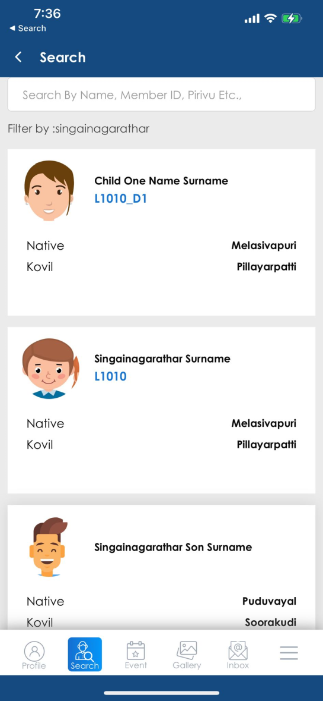
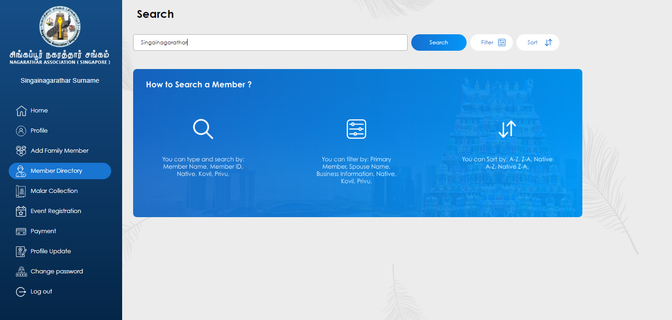
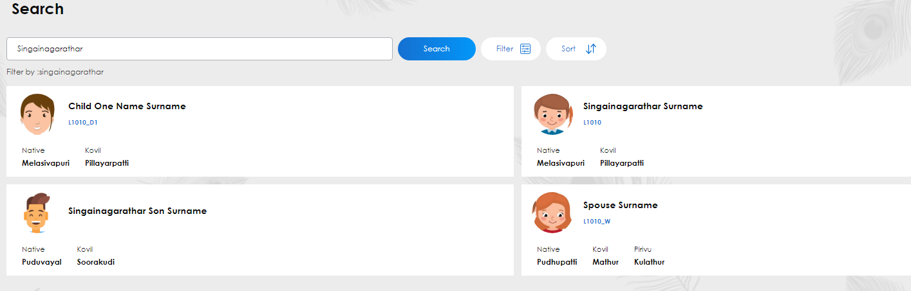
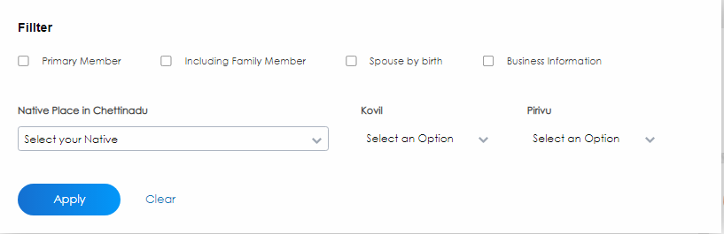
3. NAS Membership Directory Search
Search other NAS members and their family members using various search terms like Membership ID, Name, Kovil or Native
Examples : “L1010”, “Ramanathan”, “Mathur”, “Karaikudi” etc.,
Additionally, we can search on details like email ID, Mobile number, Singapore residential address/location Example : “Serangoon”
Filter search results using “Native” , “Kovil”, “Spouse by Birth”, “Only Primary Member or Including Family member”
Note : Information can only be viewed online, and No download option provided

Slide 10
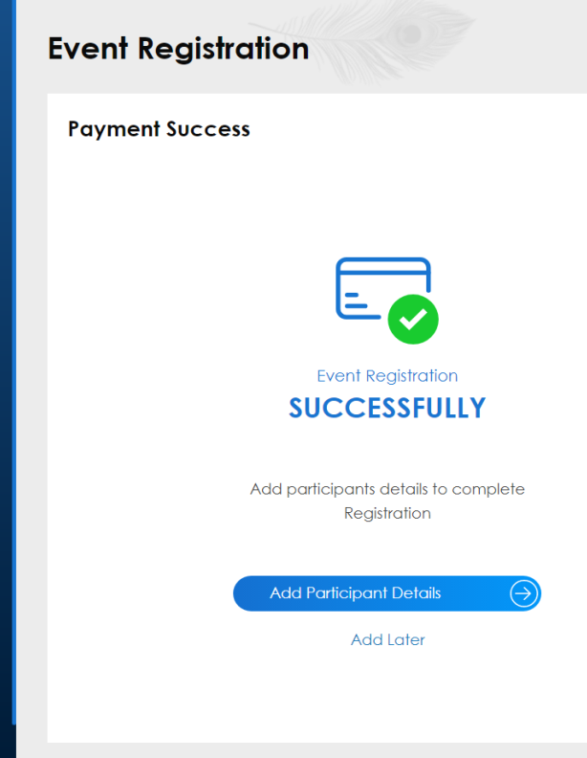
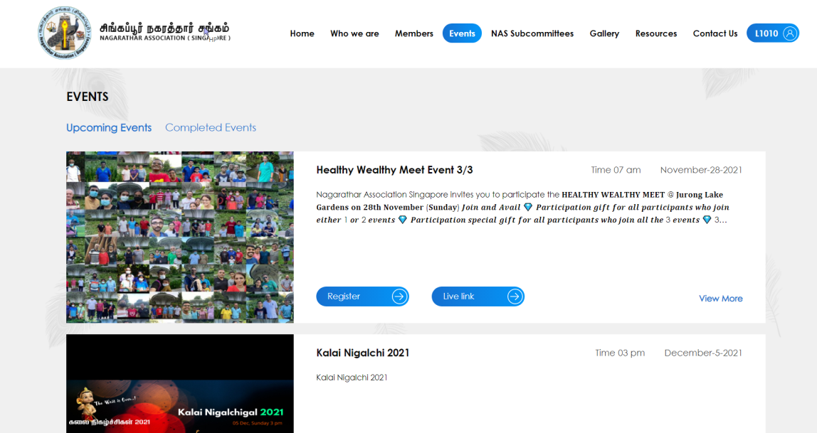
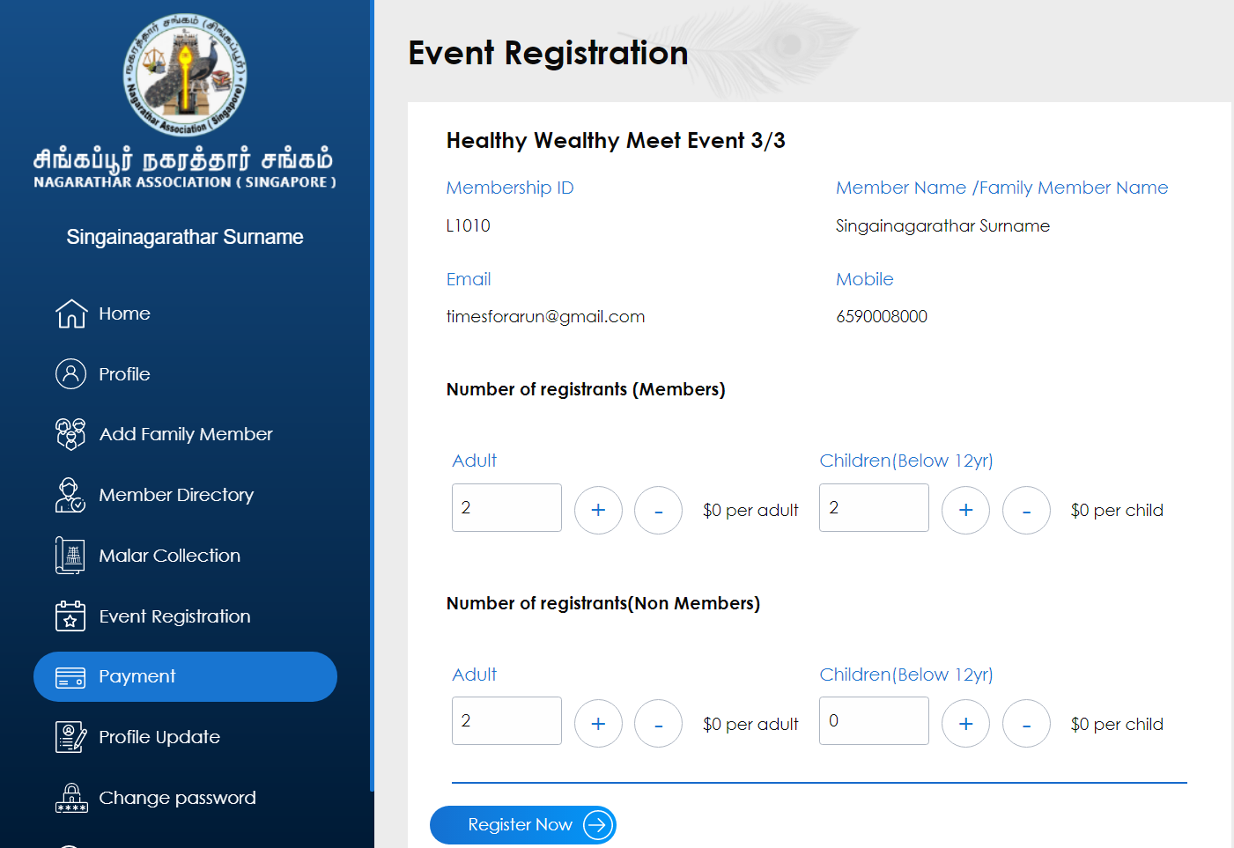
4. Event Registration
Event Registration allows NAS members to easily register for the event and provide the details of the participants instantly by choosing the names (and other details as applicable) for the number of participants chosen.
Live link for the event is also provided (as applicable) which can be used to view the lime streaming of the events
The payment can be made using the payment options including Paynow, Internet banking or Pay at Venue

Slide 11
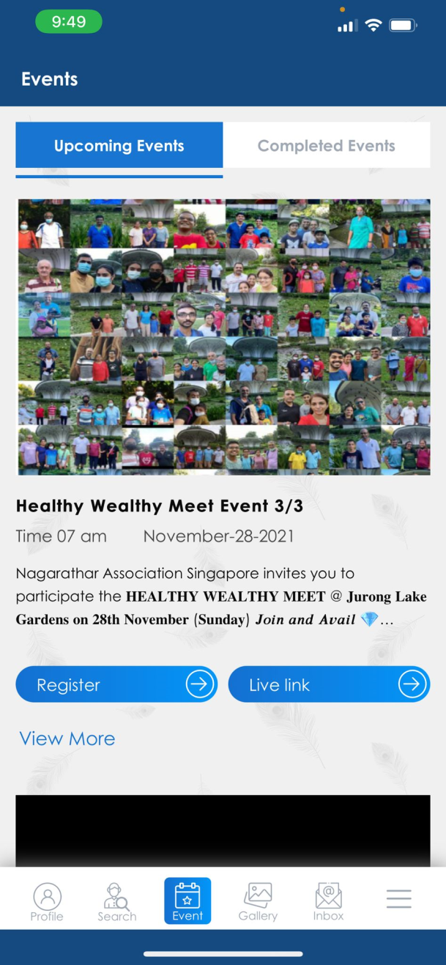
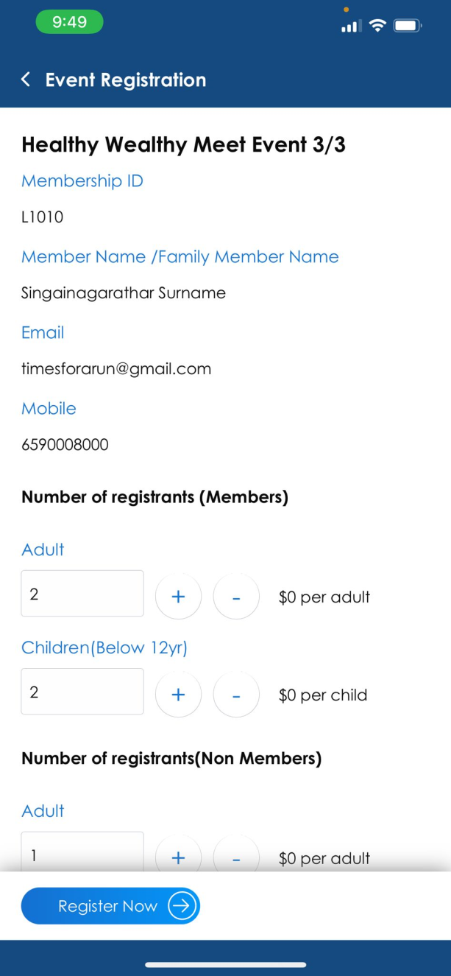
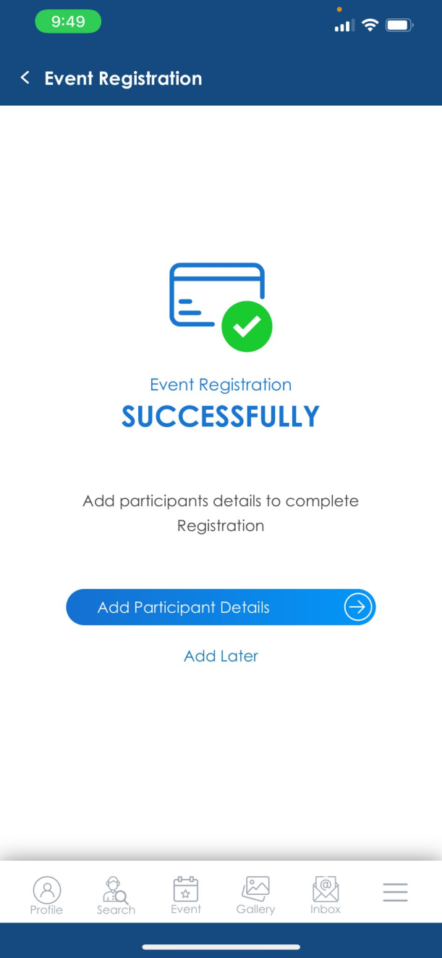
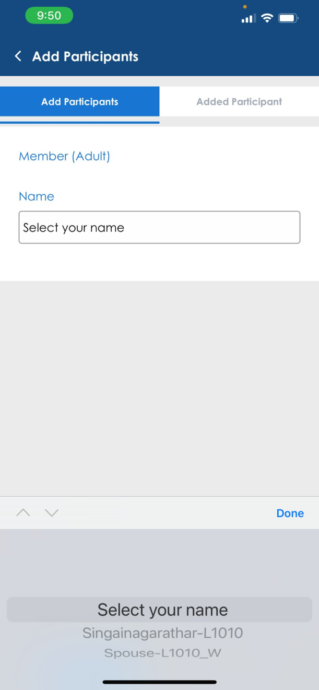
4. Event Registration

Slide 12
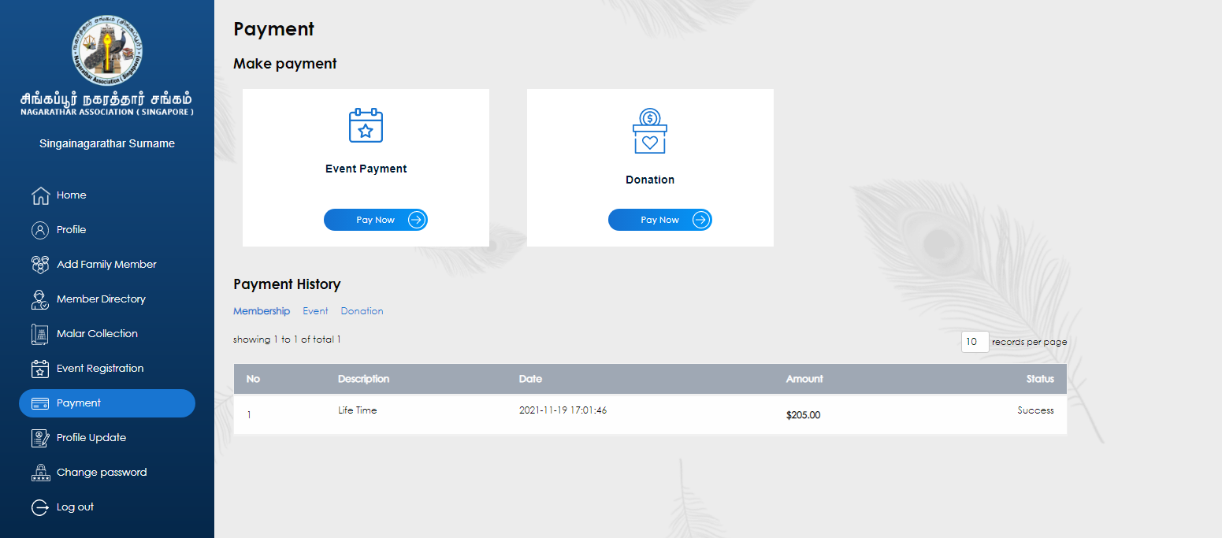
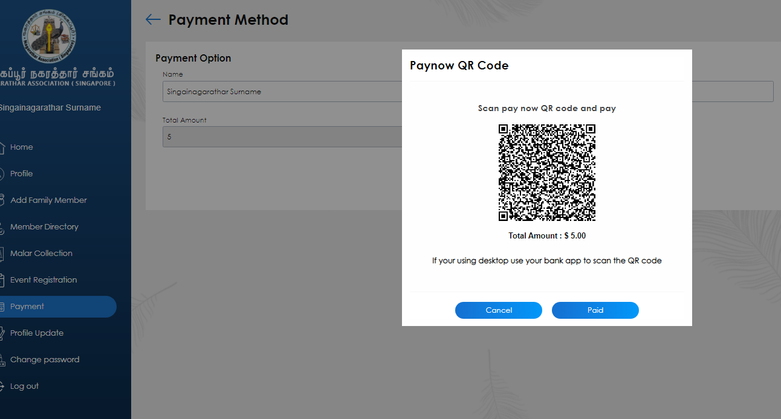
5. Payments
Event Payments
Membership Fee Payments
Donation Payments
Make Payments online using Paynow or Internet Banking
Option to Pay at Venue for events (for those who prefers to make cash payments)

Slide 13
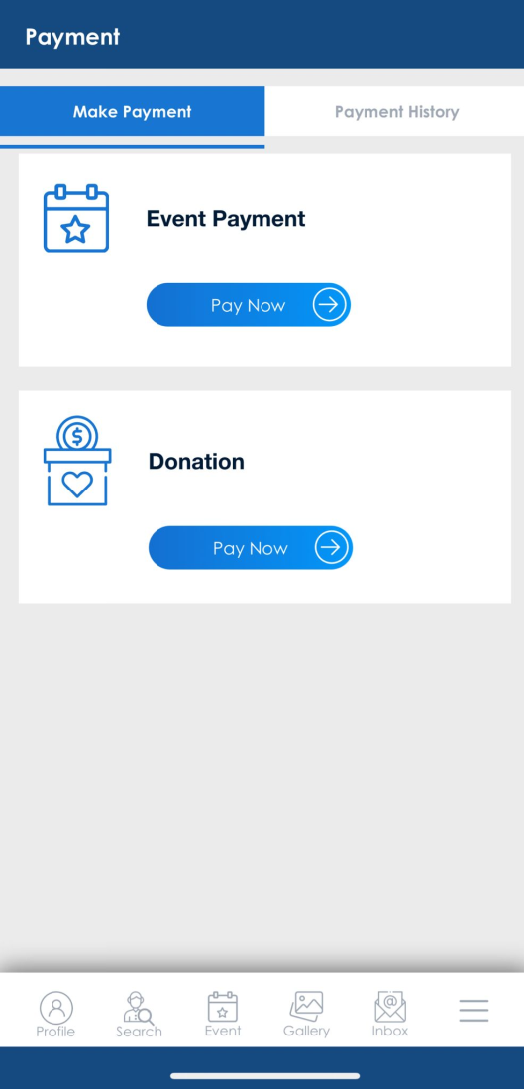
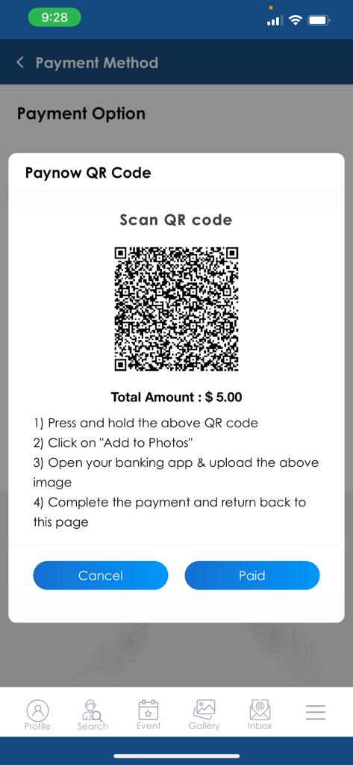
5. Payments
Paynow payment using Mobile App

Slide 14
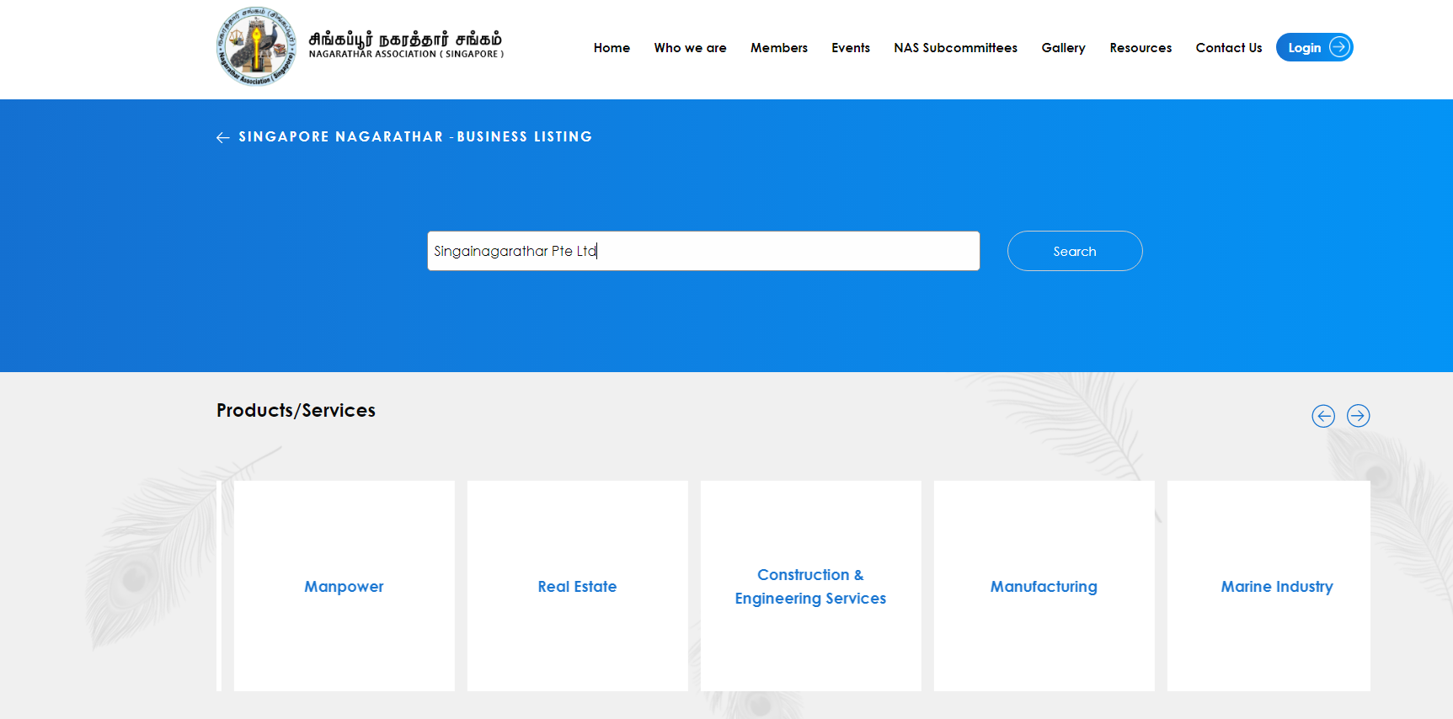
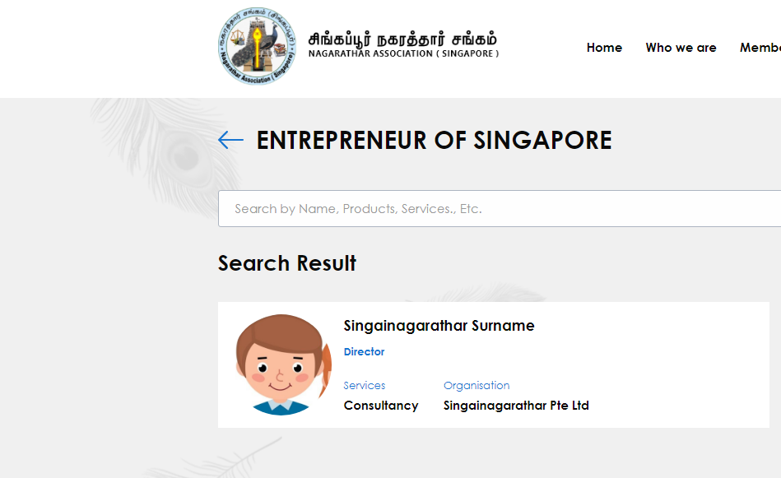
6. Business Directory Search
Business Directory Search is to enable our members and their family to look out for Nagarathar’s Business Details in a click
This feature is available in the website (open to public) in addition to our member's account
Choose Products and Services like “Finance”, “Real Estate” and enter terms like “IT Services”, “Jeweler” etc.,

Slide 15
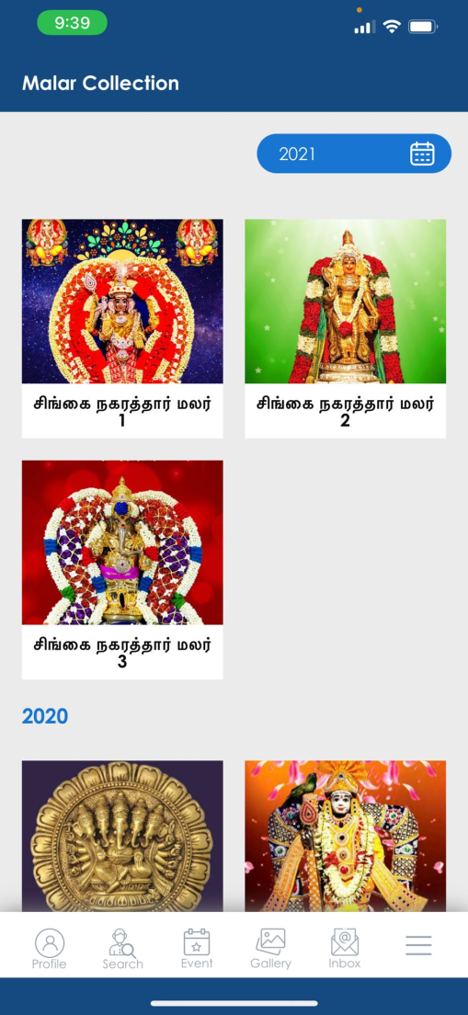
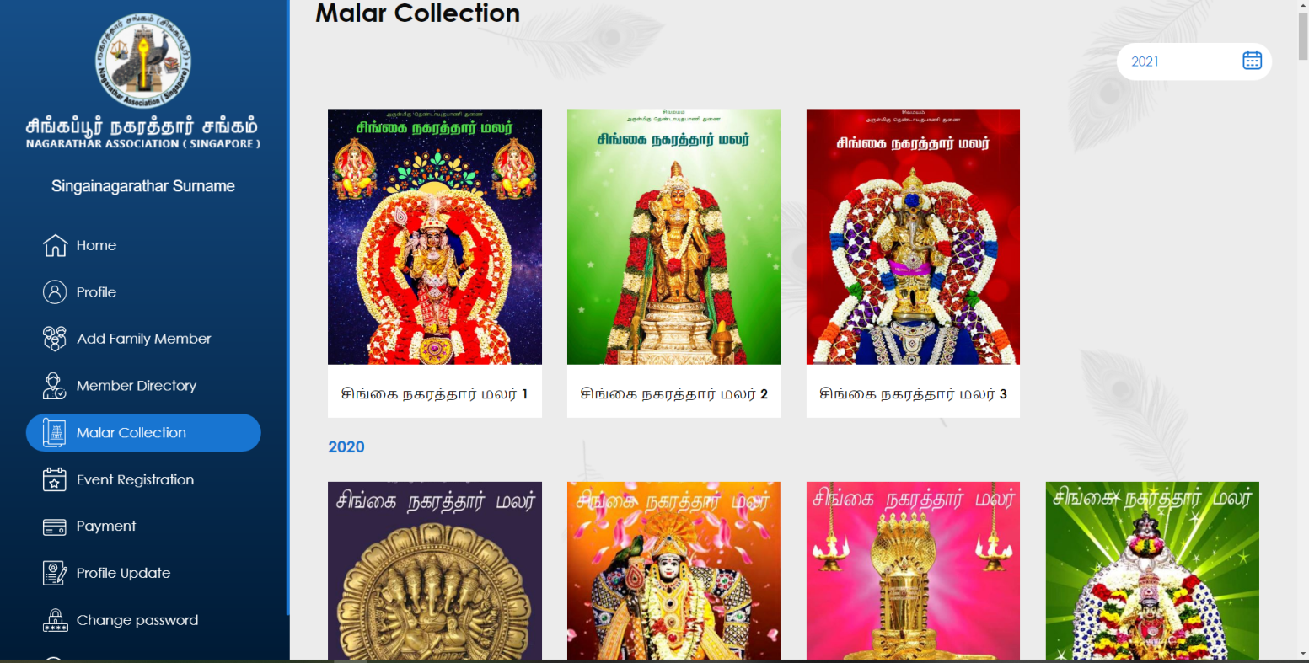
7. Malar Collections
Malar collections are available for members within the member login (Not available before login)
NAS has added the past Malar editions from 2002 till date for your reading pleasure
The Year filter allows to display the respective years’ Malar editions

Slide 16
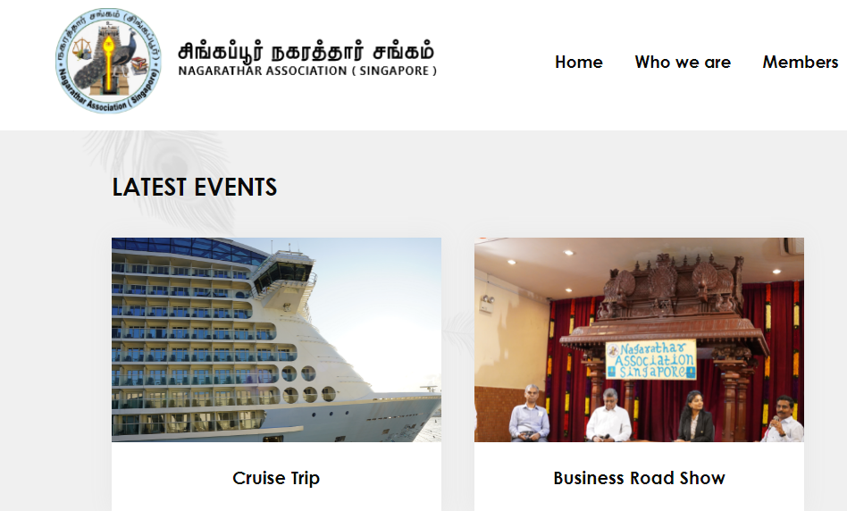
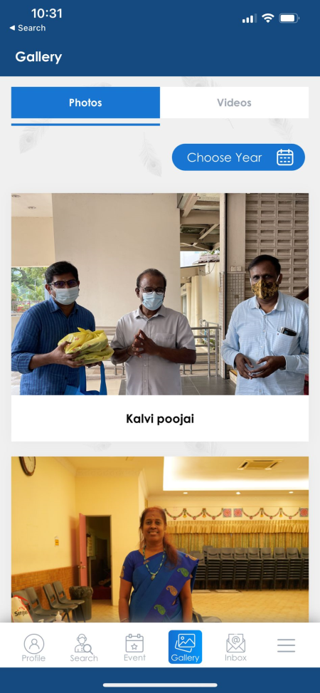
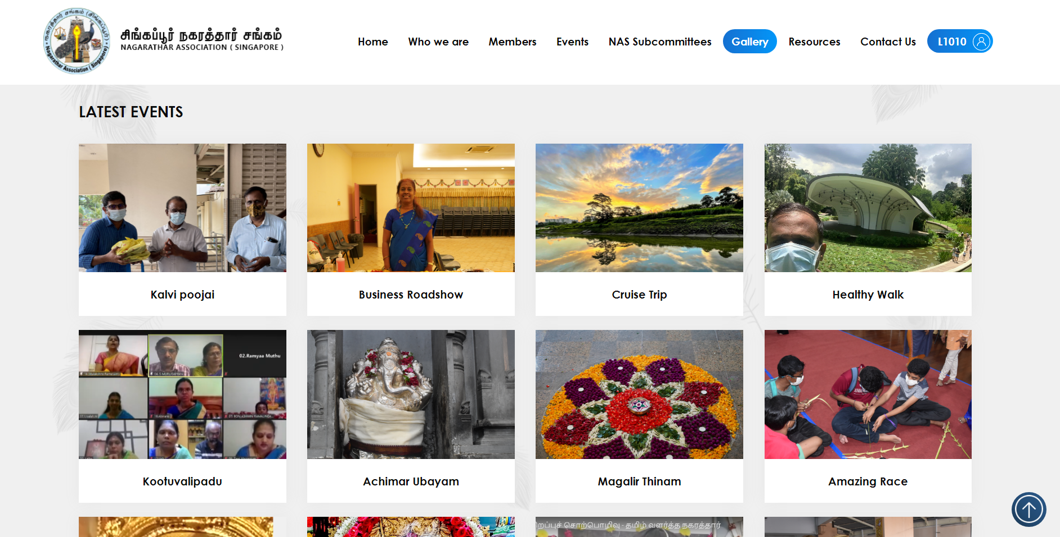
8. Photo/Video Gallery
Photo Gallery allows to capture the memories of all the events
NAS has added the available photos of past events from 2003 till date
Video Gallery allows to view the event videos (if applicable)

Slide 17
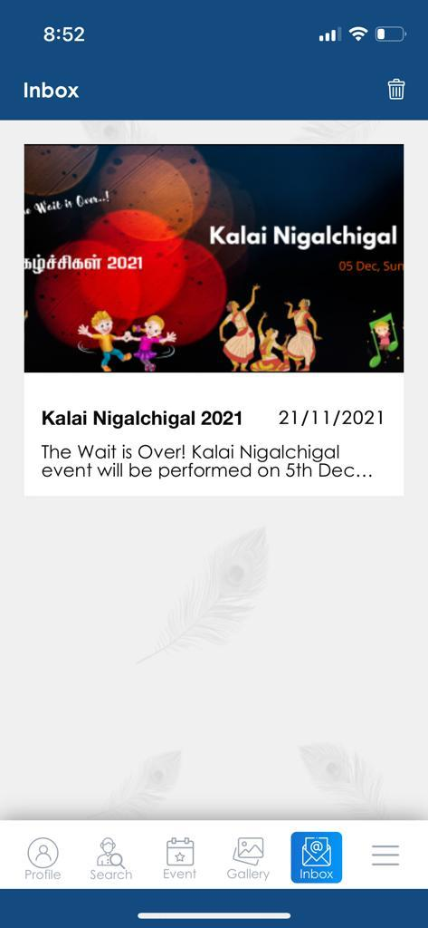
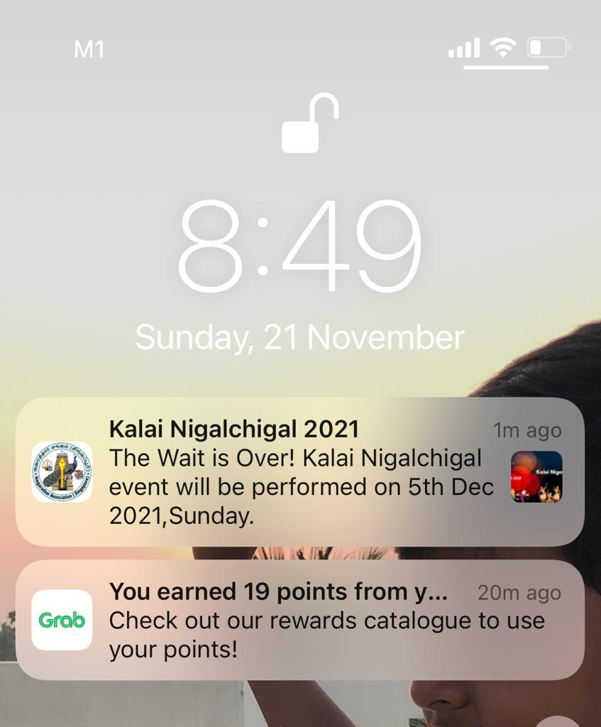

9. Push Notifications
Push Notification is a feature in the App to receive the NAS broadcasted messages
Members will receive instant notifications (if notifications are enabled for NAS App)
Helps to be informed on new events and other key updates
Members are recommended to allow notifications when installing the NAS App
This feature is only applicable to Mobile Apps

Slide 18

How to Access?
Website:
www.singainagarathar.com
Member Login
User ID : Your Membership ID (Example : L1010)
Password : Please click Forgot Password to get the reset link to the registered email ID with NAS
Follow the instructions in the email to set up the new password to access the Member Login
Use the OTP sent to the registered email for 2FA validation
Mobile App Download
Please scan the QR code to download the mobile app (App Store and Play Store)
User ID : Your Membership ID (Example : L1010)
Password : Please click Forgot Password to get the reset link to the registered email ID with NAS
Follow the instructions in the email to set up the new password to access the Member Login
Use the OTP sent to the registered email for 2FA validation

Slide 19
Points to Note
PDPA information stored in the System will not be visible to other users except Admin. No other members will be able to see the Information.
The PDF format of the Malar is available for the Members post Login and 2FA authentication.
Only Business Information entered by Members will be accessible to the public

Slide 20

For any clarifications, please write to nas@singainagarathar.com

